Slide 1


Virus Mutation Predictor
Otitoaleke Akinola
Electrical and Computer Engineering
The University of Texas at Austin

Slide 2
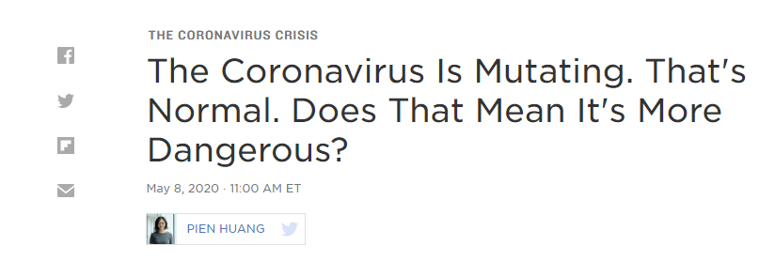
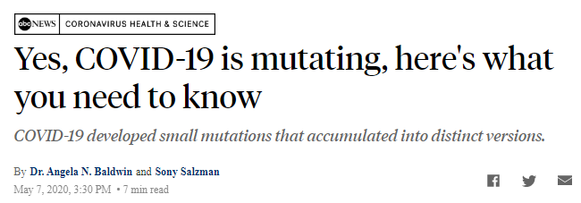
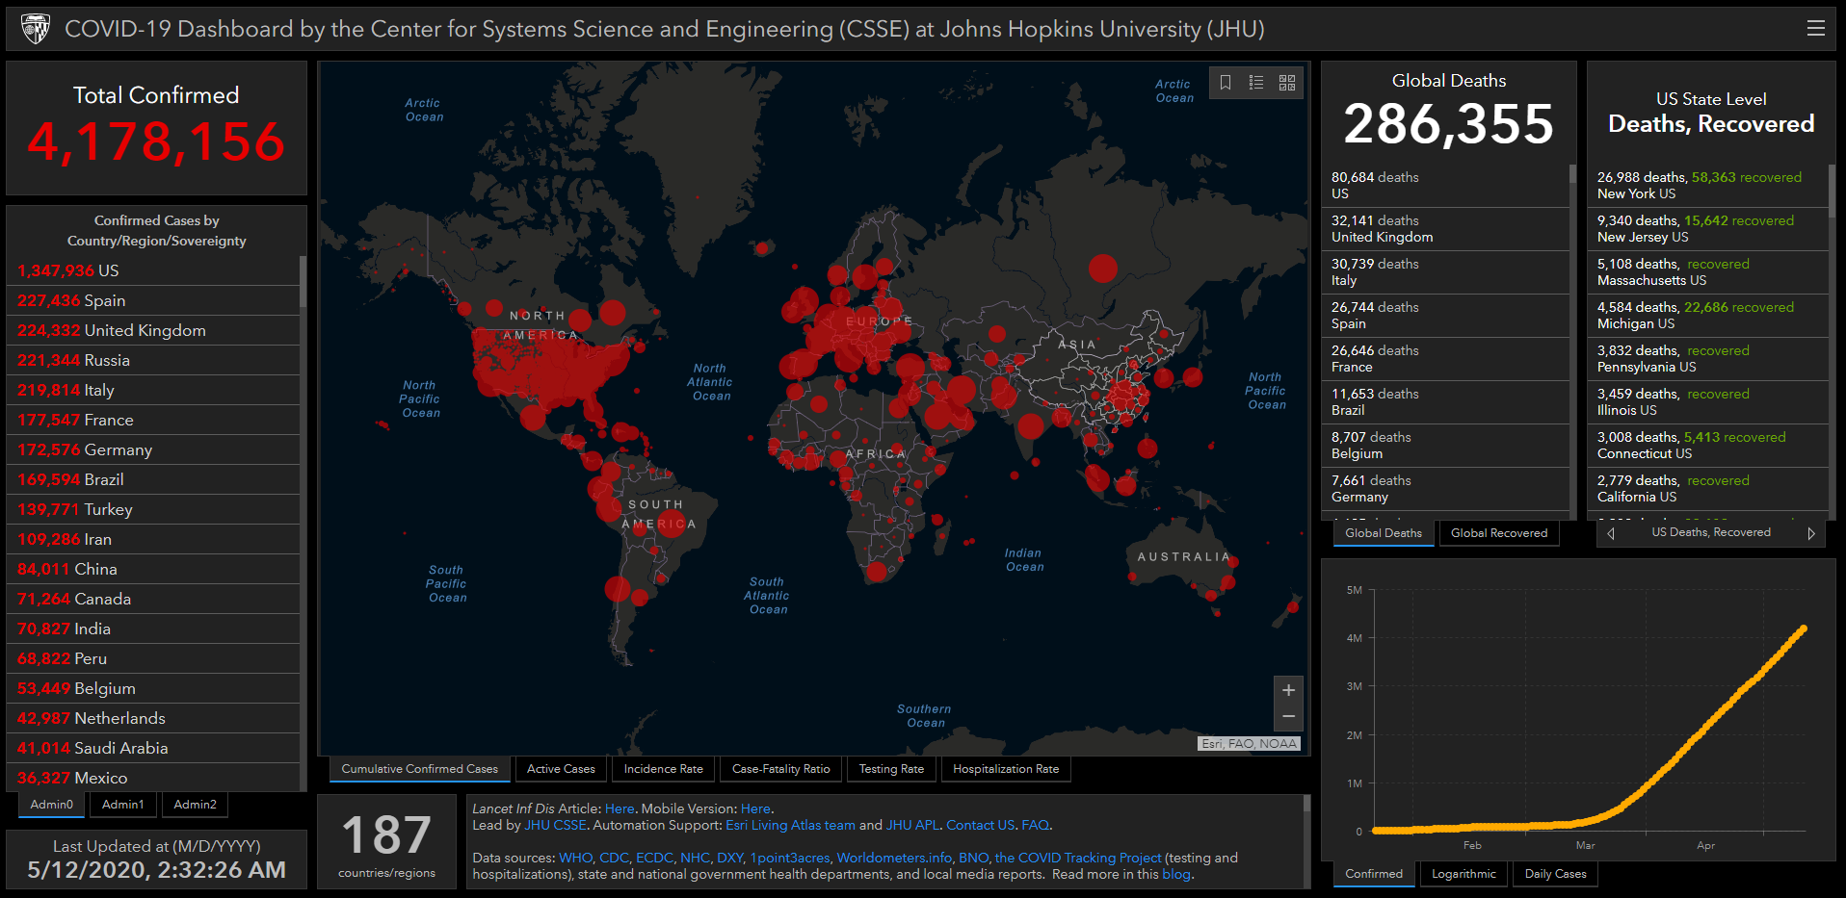

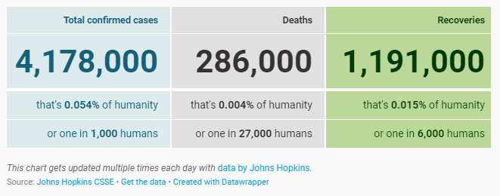
Motivations

Slide 3
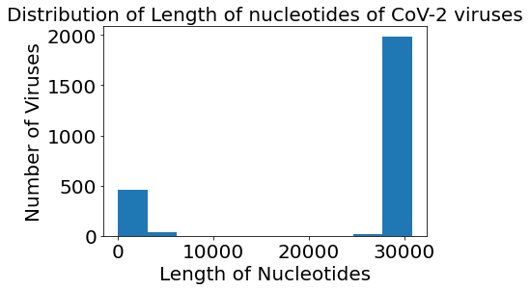
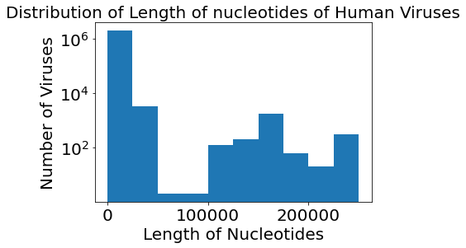
Preliminary Analysis

Slide 4




Data Sources
National Center for Biotechnology Information (NCBI)
https://www.ncbi.nlm.nih.gov/labs/virus/vssi/#/virus?SeqType_s=Nucleotide&VirusLineage_ss=Coronaviridae,%20taxid:11118
The Immune Epitope Database (IEDB)
https://www.iedb.org/epitopedetails_v3.php
Next Steps
Find
correlation between length of nucleotide over time
Find
correlation between virulence and length of nucleotides
Why Should You Care?
the mutation in genome sequence for each species with time
Find
Policy Makers would need this both at the national level and at the local level ➔ Preemptive measures
Health researchers would need this ➔ come up with necessary vaccines and treatments ahead of time
Funding agencies would know where to invest in
Save the economy billions of $$$
Use
these data to forecast the next mutation

Slide 5

Thank You

Slide 6
Next Steps
Find correlation between length of nucleotide over time
Find correlation between virulence and length of nucleotides
Find the mutation in genome sequence for each species with time
Use these data to forecast the next mutation

Slide 7
Next Steps
Find
correlation between length of nucleotide over time
Find
correlation between virulence and length of nucleotides
Find
the mutation in genome sequence for each species with time
Use
these data to forecast the next mutation

Slide 8
Next Steps
Find correlation between length of nucleotide over time
Find correlation between virulence and length of nucleotides
Find the mutation in genome sequence for each species with time
Use these data to forecast the next mutation

